Slide 1
Assignment 3
Oct. 31, 2024

Slide 2
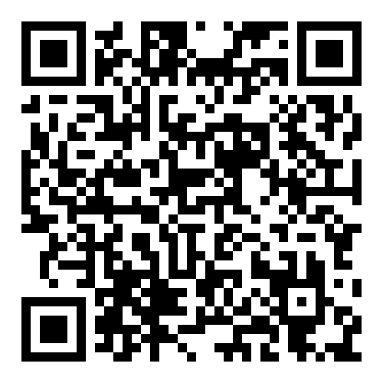
https://www.cs.nycu.edu.tw/~lhyen/np/ass3/np24f_ass3t.html
Local Testing Servers:
140.113.235.236
Final Testing Servers:
140.113.207.75

